Slide 1
Movie Recommendation System
Using Collaborative Filtering,KNN and SVD :
Submited to- Dr.Sanjeev Rao
Lokeswar Reddy (102203156)
Abhiram Epuru (102203173)

Slide 2
Introduction
Recommendation systems are integral to modern digital platforms, enabling personalized content suggestions based on users' preferences. These systems have become essential in various industries, such as e-commerce, entertainment, and social media. A recommendation system helps users discover relevant items, increasing user satisfaction and engagement.
This project focuses on developing a movie recommendation system using collaborative filtering and K-Nearest Neighbors (KNN). Collaborative filtering leverages user interactions and ratings to recommend items based on the preferences of similar users.
By utilizing these techniques, this project seeks to build a robust recommendation system that can accurately suggest movies to users based on their past behavior and preferences, with the potential for broader applications in platforms such as streaming services and digital content providers.

Slide 3
Problem Statement
With the vast amount of content available on movie streaming platforms, users often struggle to find relevant movies that match their preferences. Traditional search methods are inefficient
The main challenge in building an effective recommendation system is accurately predicting users' preferences and providing relevant recommendations despite the massive scale of data. In particular, the cold-start problem—where new users or new items (movies) lack sufficient interaction data—poses a significant barrier to delivering personalized recommendations.
By addressing both the general recommendation problem and the cold-start issue, this system aims to provide personalized and accurate movie recommendations to users, improving user satisfaction and engagement on movie streaming platforms.

Slide 4
Steps involved
Step 1- Import Dependencies
import numpy as np
import pandas as pd
import matplotlib.pyplot as plt
import seaborn as sns
so, these are some of the main import depencies and more are used……………..
Step-2 – Load Dataset and Data Analysis
MovieLens review dataset (ml-latest-small)
Ratings: 100k
Movies: 9k
Users: 600
Integrated the dataset with IMDB and TMDB data set publically available.

Slide 5
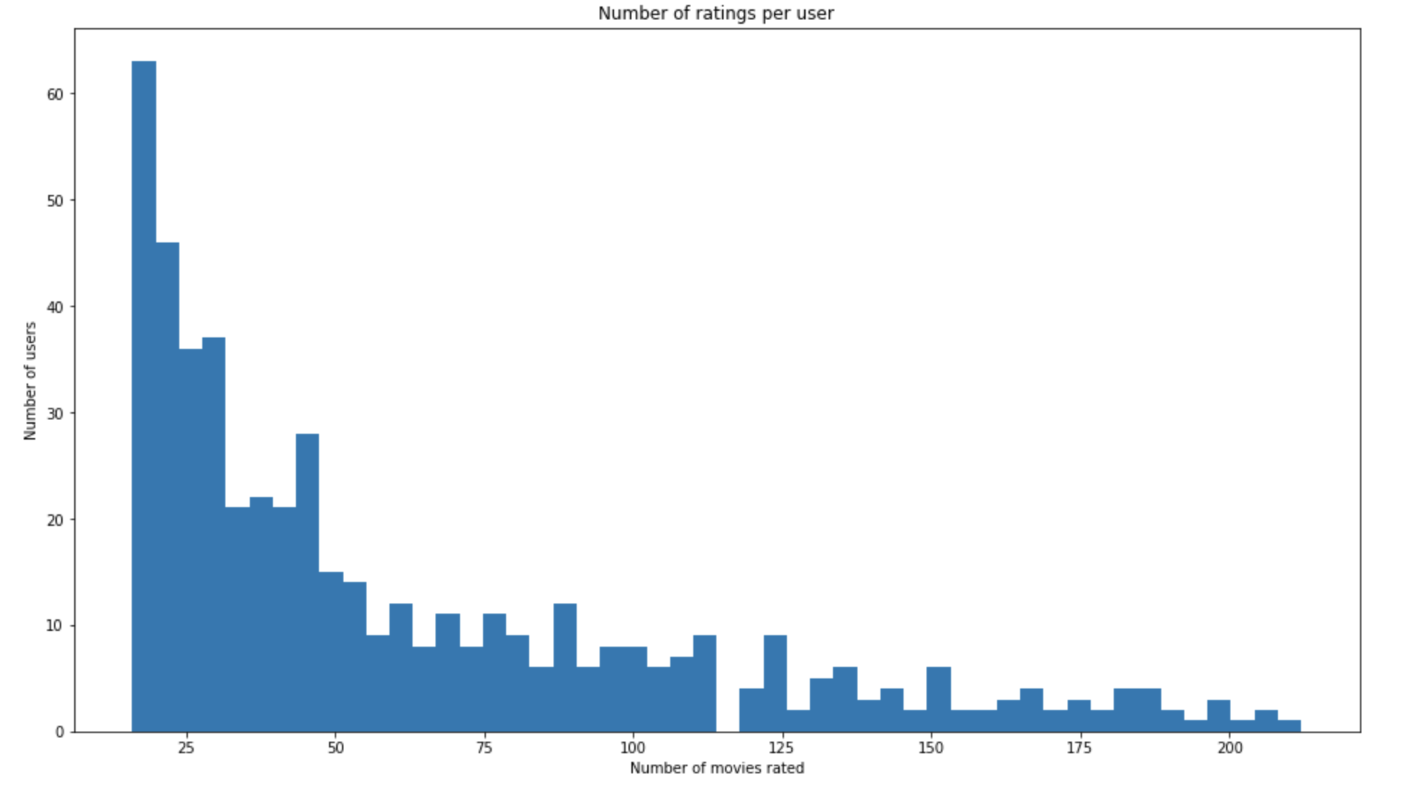
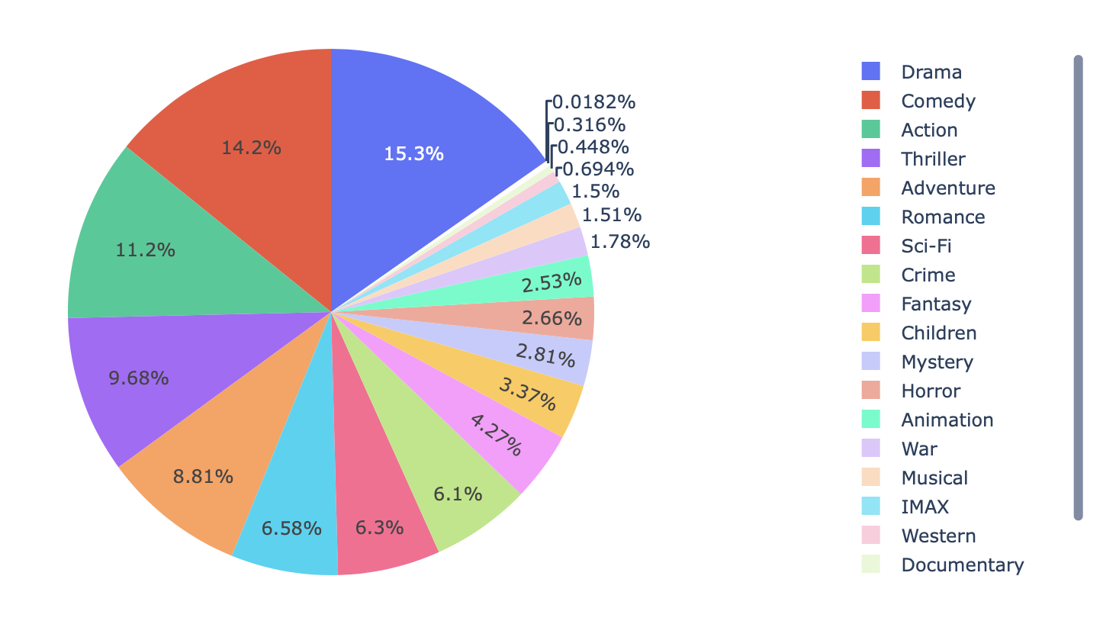
Data Analysis
Genre Distribution:
Number of ratings per user:

Slide 6
Steps involved
Step 3- Data Pre-processing
In the data pre-processing step, the ratings dataset is transformed into a sparse user-item matrix,
where rows represent users and columns represent movies. This matrix is generated using the
create_X() function, which also creates mappings between user/movie IDs and their respective indices.
The sparsity of the matrix is evaluated, revealing that only 1.7% of the matrix is filled with ratings
Step 4: Handling the cold-start problem
Collaborative filtering relies solely on user-item interactions within the utility matrix. The issue with
this approach is that brand new users or items with no iteractions get excluded from the
recommendation system. This is called the cold start problem. Content-based filtering is a way to
handle this problem by generating recommendations based on user and item features..

Slide 7
Steps involved
Step 5- Creating a movie finder function
To make our recommender more user-friendly, we can use a Python package called fuzzywuzzy which
will find the most similar title to a string that you pass in. Let's create a function called movie_finder()
which take advantage of fuzzywuzzy's string matching algorithm to get the most similar title to a user
-inputted string.
Step 6: Final Output
The Movie Recommendation System successfully generates personalized movie recommendations
based on collaborative filtering, utilizing K-Nearest Neighbors (KNN)

Slide 8
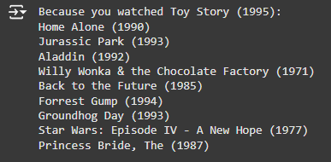
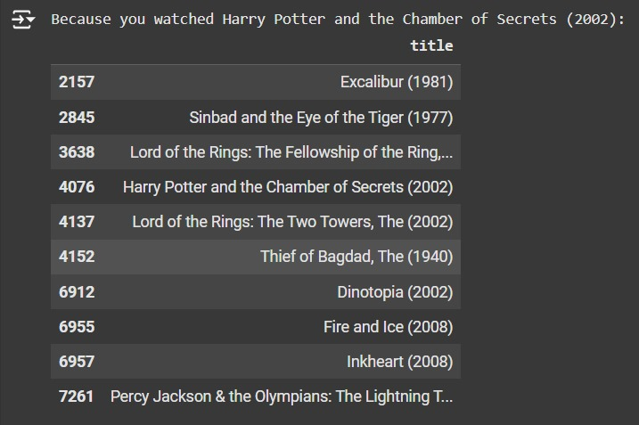
Final Result
So,In this we get Recommended Movies from our Movie Recommendation System Model,based on User
Experience.

Slide 9
Conclusion and References
In conclusion, the Movie Recommendation System developed using Collaborative Filtering, KNN, and SVD successfully generates personalized movie recommendations. The system efficiently handles sparse data, cold-start issues, and dimensionality reduction, offering an effective solution for recommending movies based on user preferences. This project demonstrates the power of collaborative filtering techniques in delivering accurate and scalable recommendations for large datasets.
References-
https://grouplens.org/datasets/movielens/latest/
https://en.wikipedia.org/wiki/Recommender_system
https://en.wikipedia.org/wiki/MovieLens
http://fastml.com/evaluating-recommender-systems/

Slide 10
THANK YOU!

